Slide 1
Movies Ontology

Slide 2
Introduction
The movies ontology is designed to represent and describe various aspects of the movie industry. It aims to capture essential information about movies
Titles
Genres
Release years
Countries
Languages
Production company
Persons such as
Actor
Director
Writer

Slide 3
Visual Representation

Slide 4
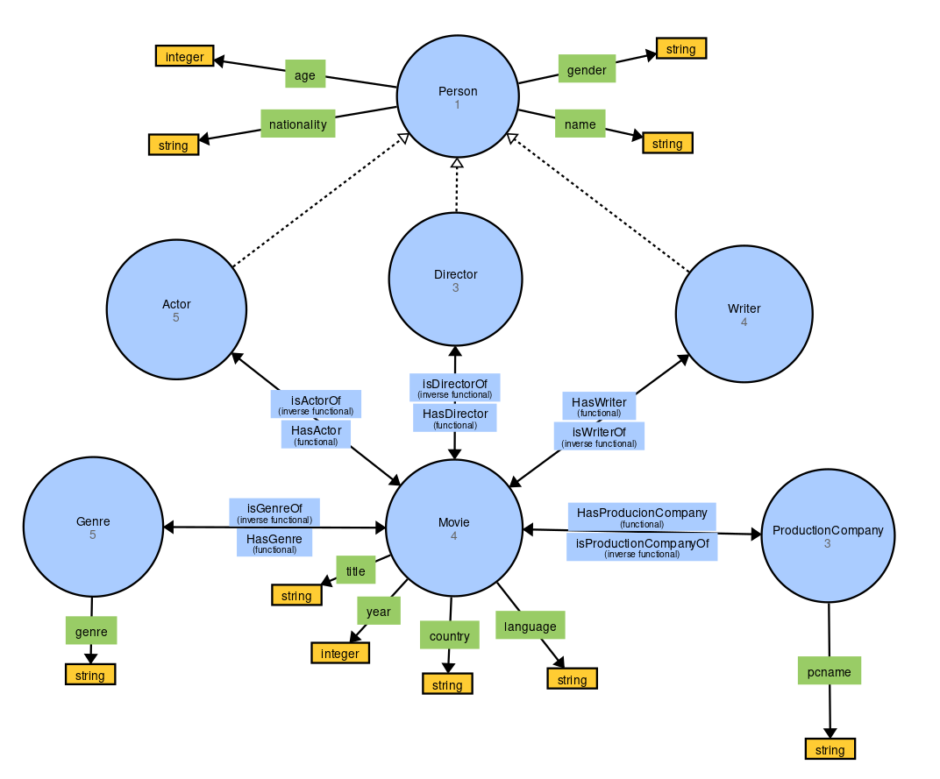

Slide 5
OntoGraf

Slide 6
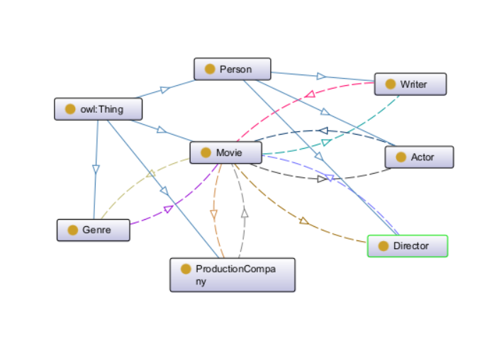

Slide 7
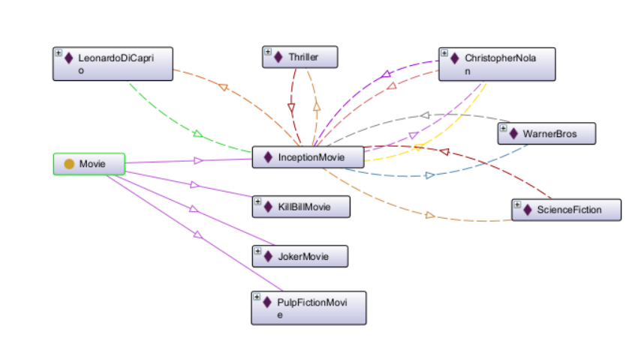

Slide 8
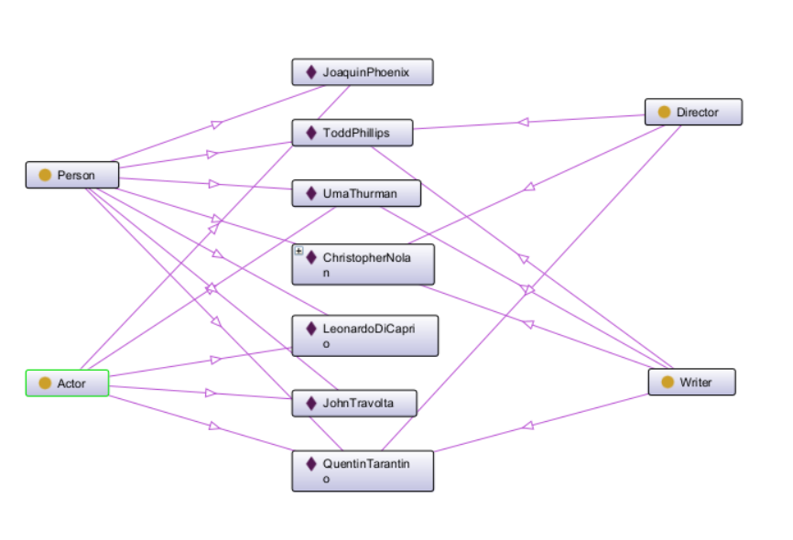

Slide 9
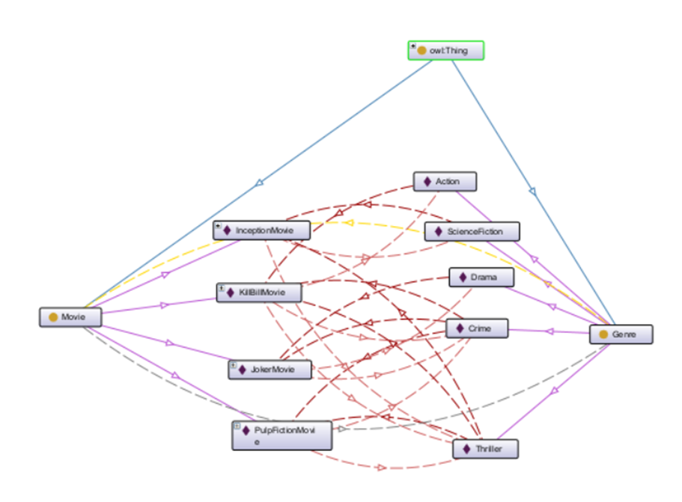

Slide 10
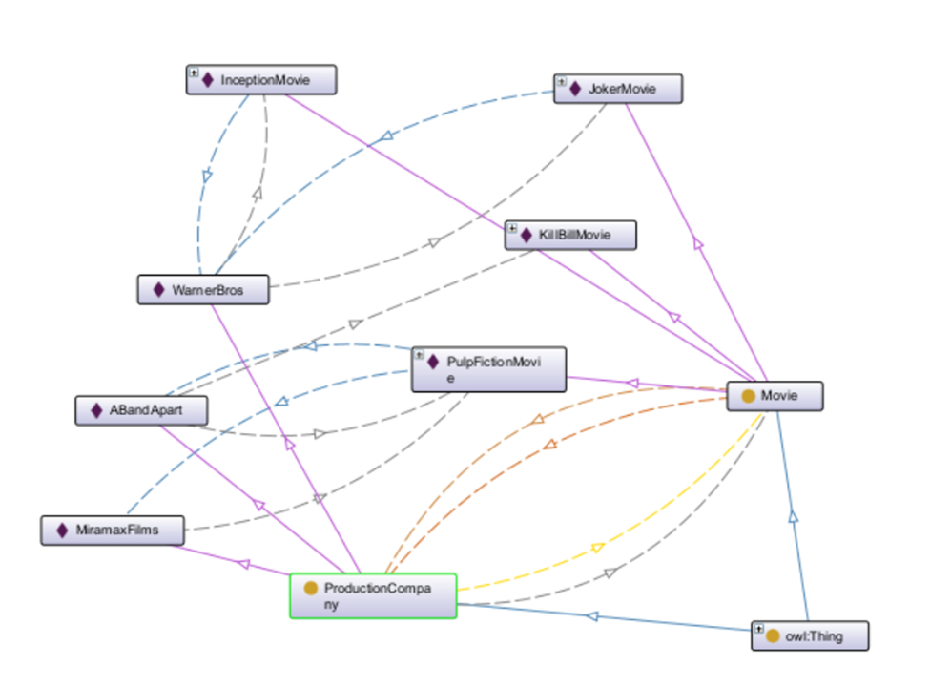

Slide 11
Queries & Results

Slide 12
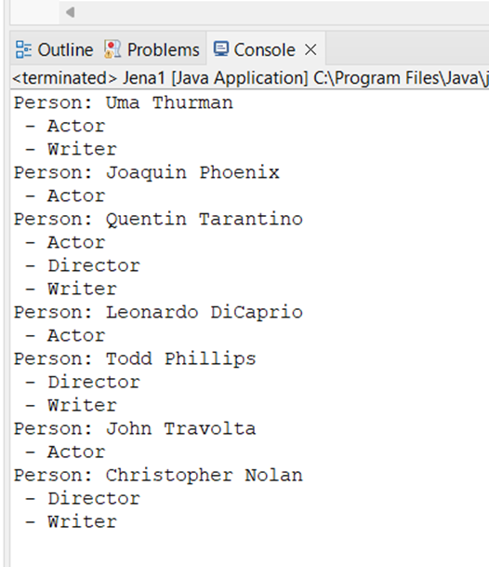
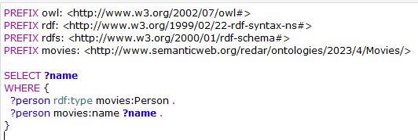
List all persons in the ontology showing if they are actor, director, and writer.

Slide 13
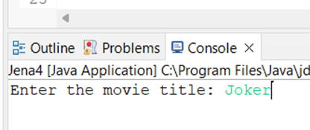
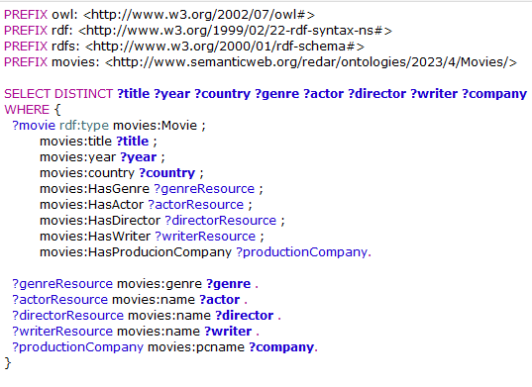
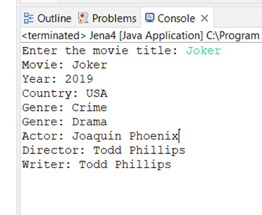
List the movie titles and its details

Slide 14
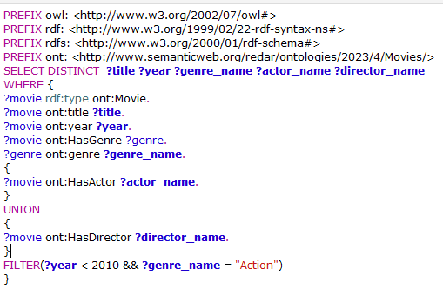
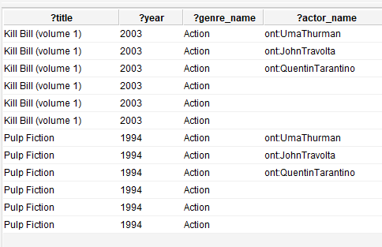
the query selects movies and retrieves their titles, along with either the associated actors or the directors. also includes a conjunction to make sure movie was before 2010 and is “Action”

Slide 15
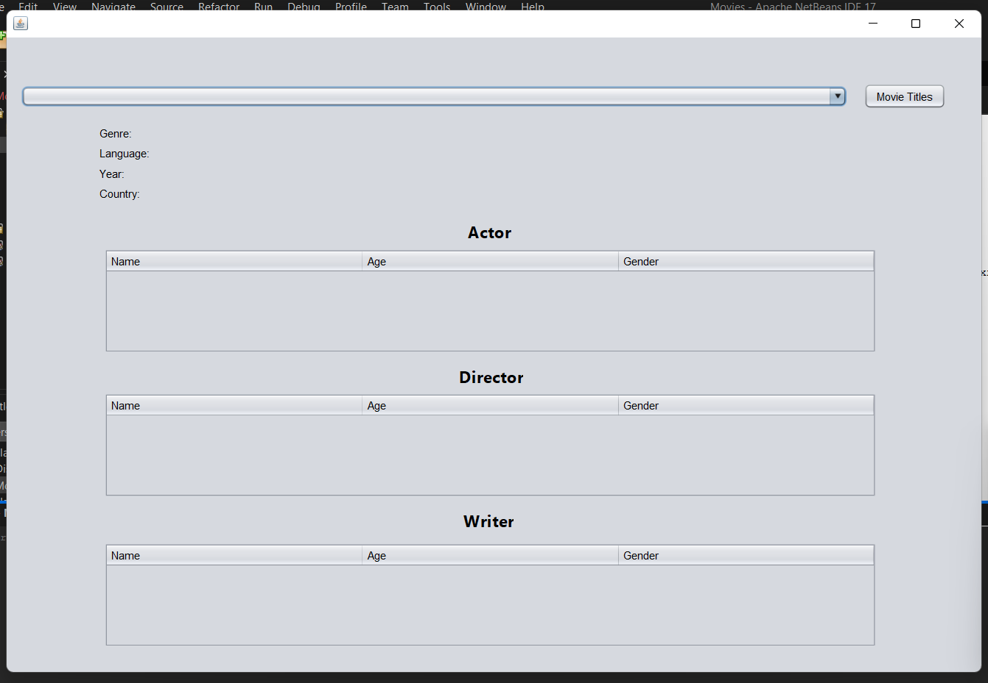

Slide 16
